Slide 1
Migrate SAP IDM to Microsoft Entra

Slide 2
Planning
Reference Architecture
Migration guidance
Licenses Requirement
Learn More

Slide 3
Planning

Slide 4
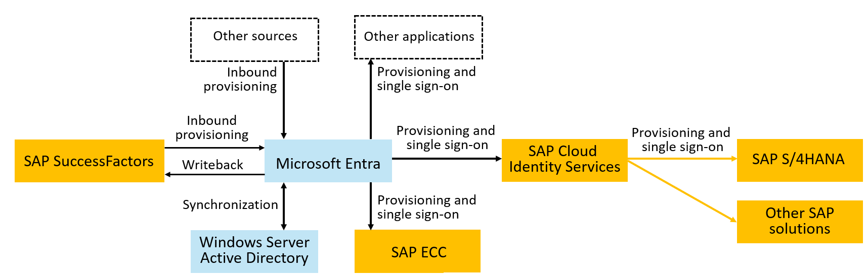
Microsoft Entra and SAP Products Integration
Notes:
The following diagram illustrates an example topology for user provisioning and single sign-on. In this topology, workers are represented in SuccessFactors, and need to have accounts in a Windows Server Active Directory domain, in Microsoft Entra, SAP ECC, and SAP cloud applications. This example illustrates an organization that has a Windows Server AD domain; however, Windows Server AD isn't required.

Slide 5
IAM & SAP Modernization: A Strategic Alignment
IAM modernization represents a critical phase within the larger SAP modernization journey.
IAM Scenario Migration: Streamlining identity management by transitioning from SAP IDM to Microsoft Entra.
SAP Modernization: Moving to cloud-based solutions like HCM to SuccessFactors for HCM and SAP R/3 to S/4HANA.
Consolidation: Cleaning up outdated integrations, roles, and access rights.
Customer Journey: Each step, whether adopting SuccessFactors or planning for S/4HANA, is part of the overall modernization direction.
Notes:
Organizations often align their Identity and Access Management (IAM) scenario migration with broader SAP modernization initiatives. This can include transitioning various non-identity management scenarios from on-premises SAP solutions to cloud services such as SuccessFactors and S/4HANA. It presents an opportune moment to streamline processes by eliminating obsolete integrations, access rights, roles, and consolidating them as needed.
IAM modernization represents a critical phase within the larger SAP modernization journey. For instance:
Transitioning from SAP Identity Management (IDM) to Microsoft Entra
Migrating from SAP Human Capital Management (HCM) to SuccessFactors
Upgrading from SAP R/3 to S/4HANA
While some customers may have already adopted SuccessFactors or other cloud services, planning for S/4HANA might still be on the horizon. Nonetheless, these steps collectively signify the overarching direction towards modernization.

Slide 6
Planning migration
Identify current and planned IAM use cases in IAM modernization strategy.
Analyze the requirements of those use cases and match those requirements to the capabilities of Microsoft Entra services.
Determine timeframes and stakeholders for implementation of new Microsoft Entra capabilities to support migration.
Determine the cutover process for your applications to move the Single Sign-On, identity lifecycle, and access lifecycle controls to Microsoft Entra.
Notes:
Since the introduction of SAP IDM, the identity and access management landscape has evolved with new applications and new business priorities, and so the approaches recommended for addressing IAM use cases will in many cases be different today than those organizations previously implemented for SAP IDM. Therefore, organizations should plan a staged approach for scenario migration. For example, one organization may prioritize migrating an end-user self-service password reset scenario as one step, and then once that is complete, moving a provisioning scenario. For another example, organization may choose to first deploy Microsoft Entra features in a separate staging tenant, operated in parallel with the existing identity management system and the production tenant, and then bring configurations for scenarios one-by-one from the staging tenant to the production tenant and decommission that scenario from the existing identity management system. The order in which an organization chooses to move their scenarios will depend upon their overall IT priorities and the impact on other stakeholders, such as end users needing a training update, or application owners. Organizations may also structure IAM scenario migration alongside other IT modernization, such as moving other scenarios outside of identity management from on-premises SAP technology to SuccessFactors, S/4HANA, or other cloud services. You may also wish to use this opportunity to clean up and remove outdated integrations, access rights or roles, and consolidate where necessary.

Slide 7
Determine the sequence of application onboarding and how applications integrate with Microsoft Entra
Establish a priority order for applications to be integrated with Microsoft Entra for SSO and for provisioning.
We recommend that organizations that have SAP cloud applications start their integrations with the SSO and provisioning integrations with SAP Cloud Identity Services as middleware.
Confirm how each application integrates with Microsoft Entra
Identify applications that integrate through SAP middleware, E.g:
If you have – or plan to have - SAP S/4HANA, you can use SAP Cloud Identity Services as middleware
If you have SAP ECC integrate Microsoft Entra directly with SAP NetWeaver for SSO and to Business Application Programming Interfaces (BAPIs) of SAP ECC for provisioning
Notes:
Plan deploying Microsoft Entra for user provisioning with SAP source and target apps - Microsoft Entra ID | Microsoft Learn
Establish a priority order for applications to be integrated with Microsoft Entra for SSO and for provisioning. Organizations generally start integrating with software as a service (SaaS) applications that support modern protocols. For SAP applications, we recommend that organizations that have SAP cloud applications start their integrations with the SSO and provisioning integrations with SAP Cloud Identity Services as middleware. Here, a user provisioning and SSO integration to Microsoft Entra can benefit multiple SAP applications.
Confirm how each application integrates with Microsoft Entra. If your application is listed as one of the SAP Cloud Identity Services provisioning target systems, such as SAP S/4HANA, you can use SAP Cloud Identity Services as middleware to bridge SSO and provisioning from Microsoft Entra to the application. If your application is SAP ECC, you can integrate Microsoft Entra directly with SAP NetWeaver for SSO and to Business Application Programming Interfaces (BAPIs) of SAP ECC for provisioning.
For non-SAP applications, follow the instructions in Integrate the application with Microsoft Entra ID to determine the supported integration technologies for SSO and provisioning for each of your applications.

Slide 8
Determine the sequence of application onboarding and how applications integrate with Microsoft Entra
Collect the roles and permissions that each application provides.
Select which roles and groups have membership that are to be governed in Microsoft Entra ID
Notes:
Plan deploying Microsoft Entra for user provisioning with SAP source and target apps - Microsoft Entra ID | Microsoft Learn
Collect the roles and permissions that each application provides. Some applications have only a single role. For example, SAP Cloud Identity Services has only one role, User, which is available for assignment. SAP Cloud Identity Services can read groups from Microsoft Entra ID for use in application assignment. Other applications might surface multiple roles to be managed through Microsoft Entra ID. These application roles typically make broad constraints on the access that a user with that role has within the app.
Other applications might also rely on group memberships or claims for finer-grained role checks. They can be provided to each application from Microsoft Entra ID in provisioning or claims issued by using federation SSO protocols. They can also be written to Active Directory as a security group membership.
Note
If you're using an application from the Microsoft Entra application gallery that supports provisioning, Microsoft Entra ID might import defined roles in the application and automatically update the application manifest with the application's roles automatically, after provisioning is configured.
Select which roles and groups have membership that are to be governed in Microsoft Entra ID. Based on compliance and risk management requirements, organizations often prioritize those application roles or groups that give privileged access or access to sensitive information. Although this tutorial doesn't include the steps for configuring access assignment, you might need to identify the roles and groups that are relevant to ensure that all their members are provisioned to the applications.

Slide 9
Define the organization's policy with user prerequisites and other constraints for access to an application
Identify if there are prerequisite requirements or standards that a user must meet before they're given access to an application
Decide how long a user who was approved for access should have access and when that access should go away.
If your organization is already governing access with an organizational role model, plan to bring that organizational role model into Microsoft Entra ID
Notes:
Identify if there are prerequisite requirements or standards that a user must meet before they're given access to an application. Organizations with compliance requirements or risk management plans have sensitive or business-critical applications. Perhaps you already documented the access policies for who should have access to those applications, prior to their integration with Microsoft Entra ID. If not, you might need to consult with stakeholders like compliance and risk management teams. You need to ensure that the policies used to automate access decisions are appropriate for your scenario.
For example, under normal circumstances, only full-time employees, or employees in a specific department or cost center, should by default have access to a particular department's application. If you're using Microsoft Entra entitlement management in Microsoft Entra ID Governance, you might choose to configure the entitlement management policy for a user from some other department who's requesting access to have one or more approvers so that those users can get access via exception.
In some organizations, requests for access by an employee might have two stages of approval. The first stage is by requesting the user's manager. The second stage is by requesting one of the resource owners responsible for data held in the application.
Decide how long a user who was approved for access should have access and when that access should go away. For many applications, a user might retain access indefinitely until they're no longer affiliated with the organization. In some situations, access might be tied to particular projects or milestones so that when the project ends, access is removed automatically. Or, if only a few users are using an application through a policy, you might configure quarterly or yearly reviews of everyone's access through the policy so that there's regular oversight. These scenarios require Microsoft Entra ID Governance.
If your organization is already governing access with an organizational role model, plan to bring that organizational role model into Microsoft Entra ID. You might have an organizational role model defined that assigns access based on a user's property, such as their position or department. These processes can ensure that users lose access eventually when access is no longer needed, even if there isn't a predetermined project end date.
If you already have an organization role definition, you can migrate organizational role definitions to Microsoft Entra ID Governance.

Slide 10
Define the organization's policy with user prerequisites and other constraints for access to an application
Inquire if there are constraints based on separation of duties
Select the appropriate conditional access policy for access to each application
Decide how exceptions to your criteria should be handled
Notes:
Inquire if there are constraints based on separation of duties. This tutorial focuses on identity lifecycle to provide a user with basic access to applications. However, when you plan application onboarding, you can identify constraints based on separation of duties to be enforced.
For example, suppose there's an application with two app roles, Western Sales and Eastern Sales. You want to ensure that a user has only one sales territory role at a time. Include a list of any pairs of app roles that are incompatible for your application. Then if a user has one role, they aren't allowed to request the second role. Microsoft Entra entitlement management incompatibility settings on access packages can enforce these constraints.
Select the appropriate conditional access policy for access to each application. We recommend that you analyze your applications and organize them into collections of applications that have the same resource requirements for the same users.
The first time you integrate a federated SSO application with Microsoft Entra ID, you might need to create a new conditional access policy to express constraints. You might need to enforce requirements for multifactor authentication (MFA) or location-based access for that application and subsequent applications. You can also configure in conditional access that users must agree to terms of use.
For more considerations on how to define a conditional access policy, see Plan a conditional access deployment.
Decide how exceptions to your criteria should be handled. For example, an application might typically only be available for designated employees, but an auditor or vendor might need temporary access for a specific project. Or, an employee who's traveling might require access from a location that's normally blocked because your organization has no presence in that location.
In these situations, if you have Microsoft Entra ID Governance, you might choose to also have an entitlement management policy for approval that has different stages, a different time limit, or a different approver. A vendor who's signed in as a guest user in your Microsoft Entra tenant might not have a manager. Instead, a sponsor for their organization, a resource owner, or a security officer could approve their access requests.

Slide 11
Decide on Provisioning and Authentication topology
Select the authoritative sources for each identity and their attributes
Decide if users exist or need to be provisioned into Windows Server AD in addition to Microsoft Entra ID.
Decide if you want to use Microsoft Entra ID to provision to SAP Cloud Identity Services or use SAP Cloud Identity Services to read from Microsoft Entra ID.
Decide if you need to provision users into SAP ECC.
Notes:
Select the authoritative sources for each identity and their attributes. This tutorial assumes SuccessFactors is the authoritative system of record source for the users who need access to SAP applications. Configuring cloud HR-driven user provisioning from SuccessFactors to Microsoft Entra ID requires planning that covers different aspects. These factors include determining the matching ID and defining attribute mappings, attribute transformation, and scoping filters.
For comprehensive guidelines on these subjects, refer to the cloud HR deployment plan. To learn about the supported entities, processing details, and how to customize the integration for different HR scenarios, refer to the SAP SuccessFactors integration reference. You might also have other authoritative sources for other identities, and some identities, such as break-glass accounts or other IT administrators, that have Microsoft Entra ID as their authoritative source.
Decide if users exist or need to be provisioned into Windows Server AD in addition to Microsoft Entra ID. You might already have existing users in Windows Server AD, which correspond to your workers in your authoritative HR source. Or perhaps you configured SAP ECC or other applications to rely on Windows Server via Lightweight Directory Access Protocol (LDAP) or Kerberos. In these situations, you provision users into Windows Server AD. These users are then synchronized into Microsoft Entra ID.
Decide if you want to use Microsoft Entra ID to provision to SAP Cloud Identity Services or use SAP Cloud Identity Services to read from Microsoft Entra ID. For more information on Microsoft Entra provisioning capabilities, see Automate user provisioning and deprovisioning to SAP Cloud Identity Services with Microsoft Entra ID. SAP Cloud Identity Services also has its own separate connector to read users and groups from Microsoft Entra ID. For more information, see SAP Cloud Identity Services - Identity Provisioning - Microsoft Entra ID as a source system.
Decide if you need to provision users into SAP ECC. You can provision users from Microsoft Entra ID into SAP ECC (formerly SAP R/3) NetWeaver 7.0 or later. If you're using other versions of SAP R/3, you can still use the guides provided in the Connectors for Microsoft Identity Manager 2016 download as a reference to build your own template for provisioning.
Ensure that organiz

Slide 12
Ensure that prerequisites are met
Ensure that your Microsoft Entra ID is ready for the compliance requirements
Compliance is a shared responsibility for Microsoft, cloud service providers (CSPs), and organizations
Use Identity Secure Score to start and implement security best practices
Ensure that your Microsoft Entra ID tenant is properly licensed*
Check that Microsoft Entra ID is already sending Audit Logs to Azure Monitor or SIEM solution as needed*
* Covered later in this doc
Notes:
Ensure that your Microsoft Entra ID and Microsoft Online Services environment is ready for the compliance requirements for the applications. Compliance is a shared responsibility among Microsoft, cloud service providers, and organizations.
Ensure that your Microsoft Entra ID tenant is properly licensed. To use Microsoft Entra ID to automate provisioning, your tenant must have as many licenses for Microsoft Entra ID P1, at a minimum, as there are workers that are sourced from the source HR application or member (nonguest) users that are provisioned.
In addition, use of Lifecycle Workflows and other Microsoft Entra ID Governance features, such as Microsoft Entra entitlement management automatic assignment policies in the provisioning process, requires Microsoft Entra ID Governance licenses for your workers. These licenses are either Microsoft Entra ID Governance or Microsoft Entra ID Governance Step Up for Microsoft Entra ID P2.
Check that Microsoft Entra ID is already sending its audit log, and optionally other logs, to Azure Monitor. Azure Monitor is optional but useful for governing access to apps because Microsoft Entra stores audit events only for up to 30 days in its audit log. You can keep the audit data for longer than this default retention period. For more information, see How long does Microsoft Entra ID store reporting data?.
You can also use Azure Monitor workbooks and custom queries and reports on historical audit data. You can check the Microsoft Entra configuration to see if it's using Azure Monitor, in Microsoft Entra ID in the Microsoft Entra admin center, by selecting Workbooks. If this integration isn't configured and you have an Azure subscription and are at least a Security Administrator, you can configure Microsoft Entra ID to use Azure Monitor.

Slide 13
Ensure that prerequisites are met
Make sure only authorized users are in the highly privileged administrative roles in your Microsoft Entra tenant
Check that your tenant has appropriate isolation
Evaluate your environment against the security best practices.
Best practices to secure with Microsoft Entra ID - Microsoft Entra | Microsoft Learn
Microsoft Entra security operations guide - Microsoft Entra | Microsoft Learn
Document the token lifetime and application's session settings
Notes:
Make sure only authorized users are in the highly privileged administrative roles in your Microsoft Entra tenant. Administrators who are at least an Identity Governance Administrator, User Administrator, Application Administrator, Cloud Application Administrator, or Privileged Role Administrator can make changes to users and their application role assignments. If you haven't recently reviewed the memberships of those roles, you need a user who's at least a Privileged Role Administrator to ensure that access review of these directory roles has started.
You should also review the users in Azure roles in subscriptions that hold the Azure Monitor, Logic Apps, and other resources needed for the operation of your Microsoft Entra configuration.
Check that your tenant has appropriate isolation. If your organization is using Active Directory on-premises, and these Active Directory domains are connected to Microsoft Entra ID, you need to ensure that highly privileged administrative operations for cloud-hosted services are isolated from on-premises accounts. Make sure that you configured to protect your Microsoft 365 cloud environment from on-premises compromise.
Evaluate your environment against the security best practices. To evaluate how to secure your Microsoft Entra ID tenant, review Best practices for all isolation architectures.
Document the token lifetime and application's session settings. At the end of this tutorial, you integrate SAP ECC or SAP Cloud Identity Services applications with Microsoft Entra for SSO. How long a user who was denied continued access can continue to use a federated application depends on the application's own session lifetime and on the access token lifetime. The session lifetime for an application depends on the application itself. To learn more about controlling the lifetime of access tokens, see Configurable token lifetimes.

Slide 14
Reference Architecture

Slide 15
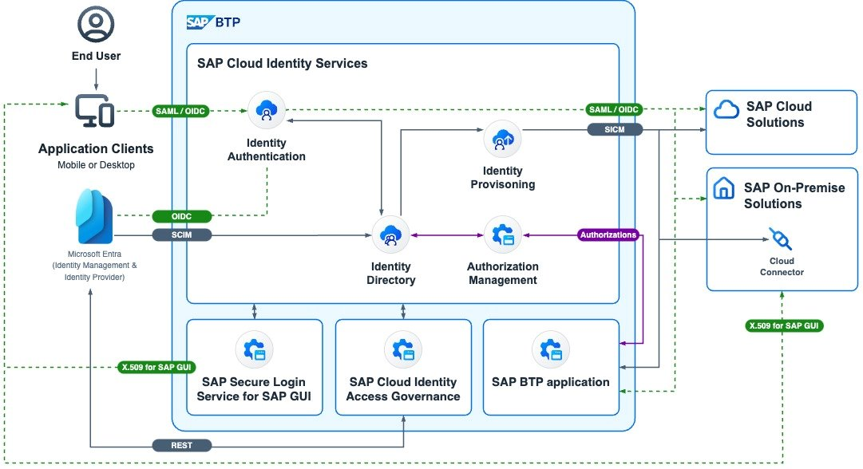
SAP Reference Architecture with Microsoft Entra
Notes:
Cross-enterprise identity management and access governance integration based on
Microsoft Entra ID and Microsoft Entra ID Governance
SAP Cloud Identity services
SAP Cloud Identity Access Governance
Organizations will be able to integrate Microsoft Entra for single sign-on and provisioning with SAP business applications including SAP S/4HANA Public Cloud, SAP Ariba, SAP Concur, and SAP SuccessFactors.
Additionally, organizations will be able to link Microsoft Entra ID and Microsoft Entra ID Governance with SAP Cloud Identity Access Governance to enable integrated identity and access risk checks along with compliance controls monitoring and management.

Slide 16
Migration Guidance

Slide 17
SAP IDM Scenarios
1. SAP IDM Identity Store
2. User Management in SAP IDM
3. Integrate with SAP SuccessFactor and Other HR sources
4. Provision Identities for SSO in Apps
5. Migrate End User Self-Service
6. Migrate access lifecycle management
7. Reporting
8. Identity Federation (B2B)
9. Directory Services
10. Extensions
Notes:
The following sections provide links to guidance on how to migrate each SAP IDM scenario to Microsoft Entra. Not all the sections may be relevant to each organization, depending upon the SAP IDM scenarios an organization has deployed.

Slide 18
SAP IDM Identity Store
SAP IDM Identity Store: A repository containing identity information such as users, groups, and their audit trails.
Microsoft Entra Tenant: An instance of Microsoft Entra ID housing single organization information, including users, groups, and devices. Provides authentication and resource access management.
Microsoft Entra ID will be the “new Identity Store”
Notes:
In SAP IDM, an Identity Store is a repository of identity information, including users, groups, and their audit trail. In Microsoft Entra, a tenant is an instance of Microsoft Entra ID in which information about a single organization resides including organizational objects such as users, groups, and devices. A tenant also contains access and compliance policies for resources, such as applications registered in the directory. The primary functions served by a tenant include identity authentication as well as resource access management. Tenants contain privileged organizational data and are securely isolated from other tenants. In addition, tenants can be configured to have an organization's data persisted and processed in a specific region or cloud, which enables organizations to use tenants as a mechanism to meet data residency and handling compliance requirements.
Organizations that have Microsoft 365, Microsoft Azure, or other Microsoft Online Services will already have a Microsoft Entra ID tenant that underlies those services. In addition, an organization may have additional tenants, such as a tenant that has specific applications and that has been configured to meet standards such as PCI-DSS applicable to those applications. For more information on determining whether an existing tenant is suitable, see resource isolation with multiple tenants. If your organization does not have yet a tenant, review the Microsoft Entra deployment plans.
Before migrating scenarios to a Microsoft Entra tenant, you should review the step-by-step guidance to:
Define the organization's policy with user prerequisites and other constraints for access to an application
Decide on the provisioning and authentication topology. Similar to SAP IDM identity lifecycle management, a single Microsoft Entra ID tenant can connect to multiple cloud and on-premises applications for provisioning and single sign-on.
Ensure organizational prerequisites are met in that tenant, including having the appropriate Microsoft Entra licenses in that tenant for the features you will be using.

Slide 19
SAP IDM Identity Store
In SAP IDM, the Identity Store represents identity data through entry types such as MX_PERSON, MX_ROLE, or MX_PRIVILEGE.
Person in Microsoft Entra ID: Represented as a User, with options to extend the user schema and issue credentials for authentication.
Business Role in Microsoft Entra ID Governance: Represented as an Entitlement Management access package, allowing for governance of application access.
Privilege/Technical Role in Microsoft Entra: Can be represented as an app role or security group, based on the target system’s authorization requirements.
Dynamic Groups in Microsoft Entra: Can be maintained automatically using dynamic groups or entitlement management with automatic assignment policies, with bulk creation via PowerShell cmdlets.
Notes:
In SAP IDM, the Identity Store represents identity data through entry types such as MX_PERSON, MX_ROLE, or MX_PRIVILEGE.
A person is represented in a Microsoft Entra ID tenant as a User. If you have existing users who are not yet in Microsoft Entra ID, you can bring them into Microsoft Entra ID. First, if you have attributes on the existing users which are not part of the Microsoft Entra ID schema, then extend the Microsoft Entra user schema with extension attributes for the additional attributes. Next, perform an upload to bulk create the users in Microsoft Entra ID from a source, such as a CSV file. Then, issue credentials to those new users so they can authenticate to Microsoft Entra ID.
A business role can be represented in Microsoft Entra ID Governance as an Entitlement Management access package. You can govern access to applications by migrating an organizational role model to Microsoft Entra ID Governance, which results in an access package for each business role. To automate the migration process, you can use PowerShell to create access packages.
A privilege or technical role in a target system could be represented in Microsoft Entra as either an app role or as a security group, depending upon the target system's requirements for how it uses Microsoft Entra ID data for authorization. For more information, see integrating applications with Microsoft Entra ID and establishing a baseline of reviewed access.
A dynamic group has separate possible representations in Microsoft Entra. In Microsoft Entra, you can automatically maintain collections of users, such as everyone with a particular value of a cost center attribute, using either Microsoft Entra ID dynamic groups or Microsoft Entra ID Governance entitlement management with access package automatic assignment policies. You can use PowerShell cmdlets to create dynamic groups or create automatic assignment policies in bulk.

Slide 20
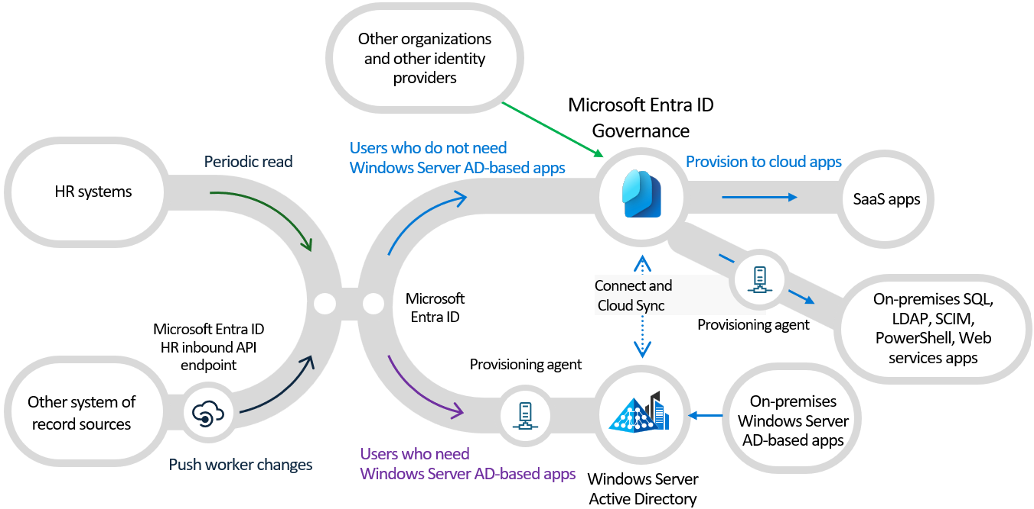
Migrate User Management Scenario
Microsoft Entra enables organizations to automate their Identity Lifecycle process
Notes:
In Microsoft Entra ID and Microsoft Entra ID Governance, you can automate identity lifecycle processes using:
Inbound provisioning from your organization's HR sources, retrieves worker information from Workday and SuccessFactors, to automatically maintain user identities in both Active Directory and Microsoft Entra ID.
Users already present in Active Directory can be automatically created and maintained in Microsoft Entra ID using inter-directory provisioning.
Microsoft Entra ID Governance lifecycle workflows automate workflow tasks that run at certain key events, such before a new employee is scheduled to start work at the organization, as they change status during their time in the organization, and as they leave the organization. For example, a workflow can be configured to send an email with a temporary access pass to a new user's manager, or a welcome email to the user, on their first day.
Automatic assignment policies in entitlement management to add and remove a user's group memberships, application roles, and SharePoint site roles, based on changes to the user's attributes. Users can also upon request, be assigned to groups, Teams, Microsoft Entra roles, Azure resource roles, and SharePoint Online sites, using entitlement management and Privileged Identity Management, as shown in the access lifecycle management section.
Once the users are in Microsoft Entra ID with the correct group memberships and app role assignments, user provisioning can create, update, and remove user accounts in other applications, with connectors to hundreds of cloud and on-premises applications via SCIM, LDAP and SQL.
For guest lifecycle, you can specify in entitlement management the other organizations whose users are allowed to request access to your organization's resources. When one of those users's request is approved, entitlement management automatically adds them as a B2B guest to your organization's directory, and assigns appropriate access. And entitlement management automatically removes the B2B guest user from your organization's directory when their access rights expire or are revoked.
Access reviews automates recurring reviews of existing guests already in your organization's directory, and removes those users from your organization's directory when they no longer need access.

Slide 21
Integrate with HR Sources
Organizations may have either on-premises HR systems such as SAP HCM or cloud-based HR systems such as SAP SuccessFactors.
Historically, integration with on-premises HR systems for HR driven provisioning leveraged on-premises HR tools such as SAP Identity Management (SAP IDM) or Microsoft Identity Manager (MIM) to create users in Active Directory.
Microsoft Entra ID supports integrating your HR source with both cloud and on-premises.

Slide 22
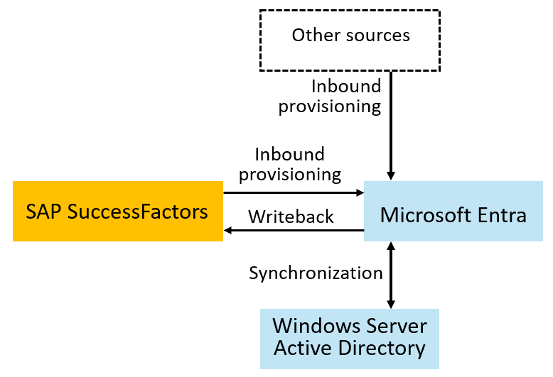
Integrate with HR Sources – SAP SuccessFactors
Organizations with SAP SuccessFactors easily connect to bring identities for employees from SuccessFactors into Microsoft Entra ID or from SuccessFactors into on-premises Active Directory
Notes:
Migrate identity management scenarios from SAP IDM to Microsoft Entra | Microsoft Learn

Slide 23
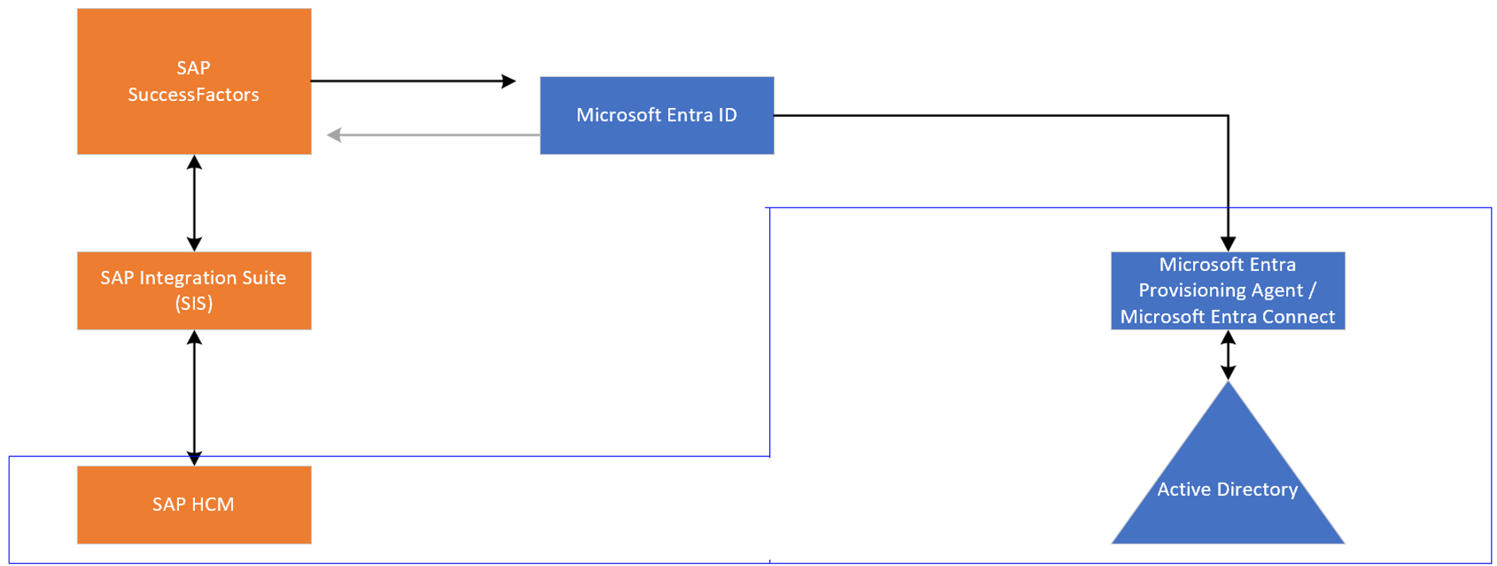
Integrate with HR Sources – SAP HCM + SF
Customers with HCM + SF can leverage this architecture
Notes:
What is HR-driven provisioning with Microsoft Entra ID? - Microsoft Entra ID | Microsoft Learn
Some organizations also used SAP IDM to read from SAP Human Capital Management (HCM). Organizations that use both SAP SuccessFactors and SAP Human Capital Management (HCM) can also bring identities into Microsoft Entra ID. By using SAP Integration Suite, you can synchronize lists of workers between SAP HCM and SAP SuccessFactors. From there, you can bring identities directly into Microsoft Entra ID or provision them into Active Directory Domain Services by using the native provisioning integrations mentioned earlier.

Slide 24
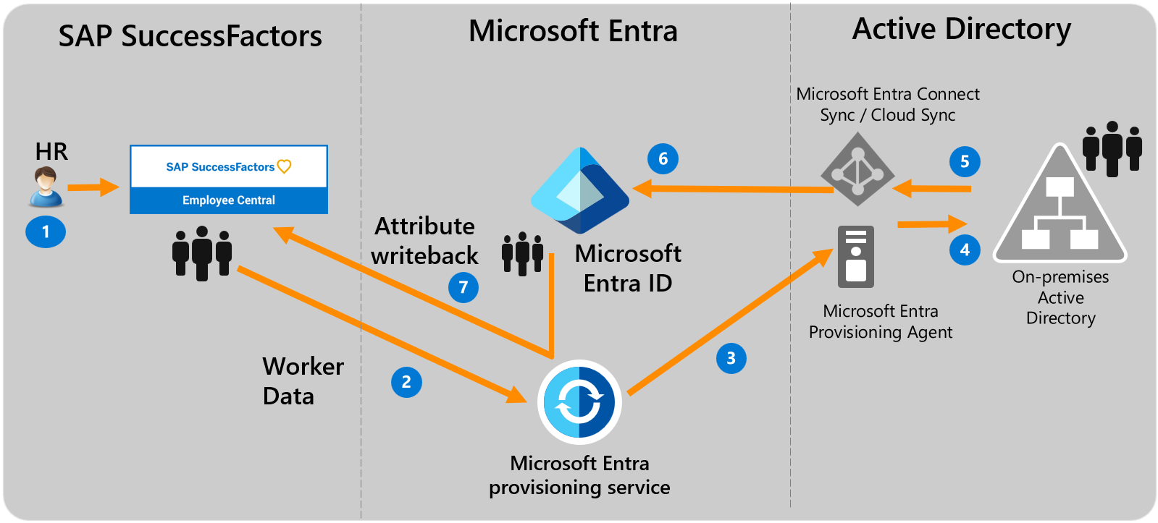
Integrate with HR Sources – SAP SF + AD DS (Hybrid Identity)
Notes:
https://learn.microsoft.com/en-us/entra/identity/saas-apps/sap-successfactors-inbound-provisioning-tutorial

Slide 25
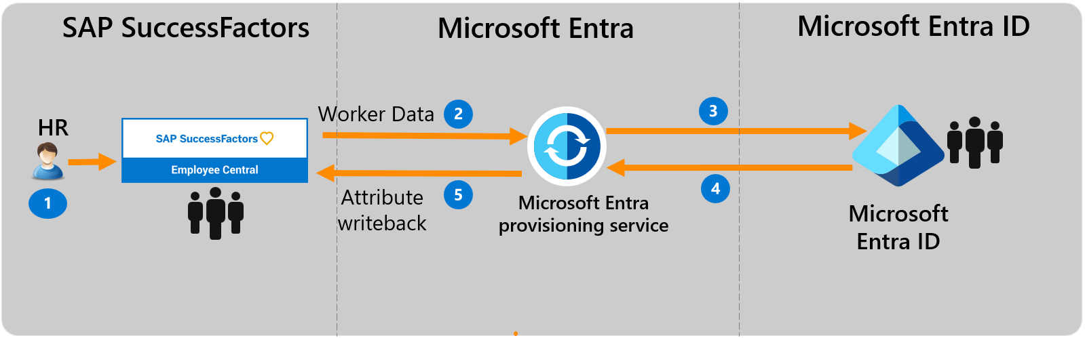
Integrate with HR Sources – SAP SF + Entra ID (Cloud-only)
Notes:
https://learn.microsoft.com/en-us/entra/identity/app-provisioning/sap-successfactors-integration-reference
https://learn.microsoft.com/en-us/entra/identity/saas-apps/sap-successfactors-inbound-provisioning-cloud-only-tutorial

Slide 26
Migrate User Management Scenario
IT Administrators uses Microsoft Entra Admin Center, Microsoft Graph API or PowerShell to perform day-to-day identity management activities such as:
User management*
Group Management*
Provisioning (HR Inbound, Target App)
Access Policies and Entitlement Management
Audit, Monitoring and Reporting
* For Hybrid environments with On-Premises Active Directory, AD Admin Center, ADUC or PowerShell and are the main tools

Slide 27
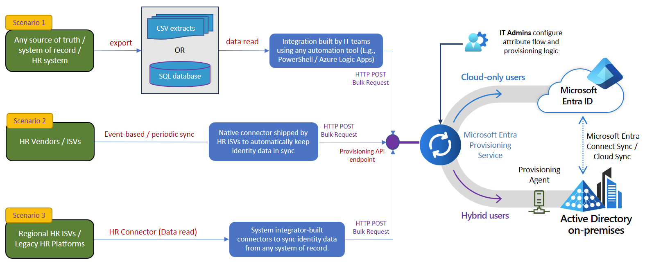
Integrate with Other HR Sources – API-Driven
Notes:
https://learn.microsoft.com/en-us/entra/identity/app-provisioning/inbound-provisioning-api-concepts

Slide 28
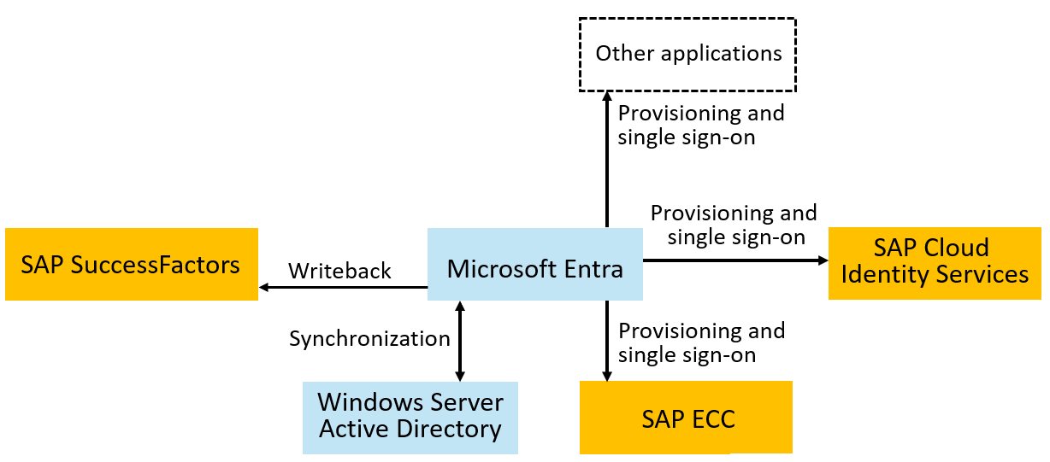
Provision to SAP systems
Microsoft has connectors to SAP ECC, SAP Cloud Identity Servers and
Other SAP and non-SAP systems.
Notes:
organizations with SAP IDM will have used it to provision users into SAP ECC, SAP IAS, SAP S/4HANA, or other SAP applications. Microsoft Entra has connectors to SAP ECC, SAP Cloud Identity Services, and SAP SuccessFactors. Provisioning into SAP S/4HANA or other applications requires the users to first be present in Microsoft Entra ID. Once you have users in Microsoft Entra ID, you can provision those users from Microsoft Entra ID to SAP Cloud Identity Services or SAP ECC, to enable them to sign in to SAP applications. SAP Cloud Identity Services then provisions the users originating from Microsoft Entra ID that are in the SAP Cloud Identity Directory into the downstream SAP applications, including SAP S/4HANA Cloud, SAP S/4HANA On-premise through the SAP cloud connector, AS ABAP, and others.

Slide 29
Provision to SAP systems – SAP Cloud Identity Services
For SAP Cloud Identity Services, confirm the SAP Cloud Identity Services have the necessary schema mappings for those applications, and provision the users from Microsoft Entra ID to SAP Cloud Identity Services.
SAP Cloud Identity Services will subsequently provision users into the downstream SAP applications, as necessary.
You can also automate changes to the application role assignments in Microsoft Entra ID for SAP Cloud Identity Services.

Slide 30
Provision to SAP systems – On-Premises SAP ECC
For SAP ECC, confirm that the necessary Business APIs (BAPIs) for SAP ECC are ready for Microsoft Entra to use for identity management, then provision the users from Microsoft Entra ID to SAP ECC.
If you are using SAP NetWeaver AS for Java with Windows Server Active Directory as its data source, then Microsoft Entra SuccessFactors inbound can be used to automatically create and update users in Windows Server AD.
If you are using SAP NetWeaver AS for Java with another LDAP directory as its data source, then you can configure Microsoft Entra ID to provision users into LDAP directories.

Slide 31
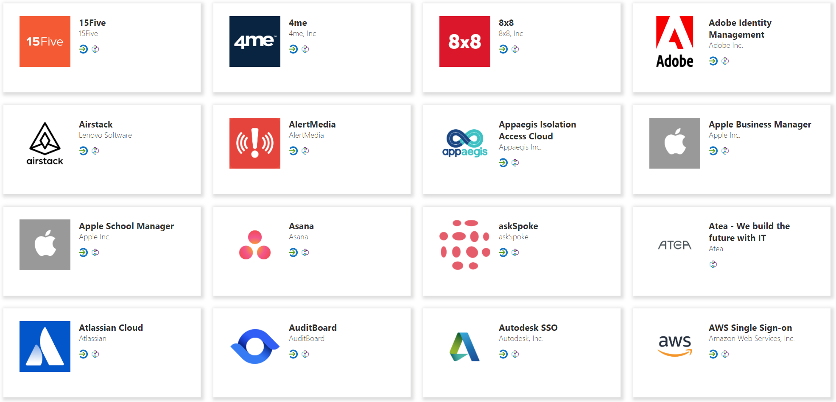


Provision to non-SAP Systems – SaaS
Entra Provisioning service connects to 3rd party apps via SCIM endpoints for user management
Automatically create, update or deactivate accounts in applications.
Ensure that the identities in your apps and systems are kept up to date based on changes in the directory or your human resources system.
Provision groups to applications that support them.
Take advantage of customizable attribute mappings that define what user data should flow from the source system to the target system.
Monitor and audit who has been provisioned into your applications.
The provisioning service provides alerts for critical events and allows for Log Analytics integration where you can define custom alerts to suit your business needs.
Microsoft
Entra ID
SaaS applications

Slide 32




Provision to non-SAP Systems – On-Premises
Users and schema defined in the cloud
Supports provisioning from custom schema extensions to app-specific properties.
Single sign-on and provisioning
SCIM
Translation to the provisioning protocols expected by apps
Microsoft-delivered connectors: LDAP, SQL, etc.
Ecosystem of third-party connectors for other apps requiring custom API integrations
Customers can re-use their existing MIM configuration
Microsoft Entra
provisioning agents
SOAP
LDAP
PS
SQL

Slide 33
Migrate Authentication and SSO
Microsoft Entra ID acts as a security token service, enabling users to authenticate to Microsoft Entra ID with multi-factor and passwordless authentication, and then have single sign-on to all their applications. Microsoft Entra ID single sign-on uses standard protocols including SAML, OpenID Connect and Kerberos.
We recommend to migrate authentication and SSO capabilities to Microsoft Entra for better security, consistent and user experience
Tutorial: Microsoft Entra single sign-on (SSO) integration with SAP Cloud Identity Services - Microsoft Entra ID | Microsoft Learn
Notes:
App Integration Tutorials for use with Microsoft Entra ID - Microsoft Entra ID | Microsoft Learn

Slide 34
Migrate Authentication and SSO
Tutorial: Microsoft Entra single sign-on (SSO) integration with SAP Cloud Identity Services - Microsoft Entra ID | Microsoft Learn
Tutorial: Microsoft Entra SSO integration with SAP Business Technology Platform - Microsoft Entra ID | Microsoft Learn
Tutorial: Microsoft Entra single sign-on (SSO) integration with SAP HANA - Microsoft Entra ID | Microsoft Learn
Tutorial: Microsoft Entra single sign-on (SSO) integration with SAP Fiori - Microsoft Entra ID | Microsoft Learn
Tutorial: Microsoft Entra single sign-on (SSO) integration with SAP NetWeaver - Microsoft Entra ID | Microsoft Learn
And more…
Notes:
App Integration Tutorials for use with Microsoft Entra ID - Microsoft Entra ID | Microsoft Learn

Slide 35
Migrate user Self-Service
Organizations may have used SAP IDM Logon Help to enable their end users to reset their Windows Server AD password.
Microsoft Entra self-service password reset (SSPR) gives users the ability to change or reset their password, without needing administrator or help desk involvement.
Self-service password reset deep dive
Microsoft Entra also supports end user self-service for group management, and self-service access requests, approval, and reviews.
Notes:
Organizations may have used SAP IDM Logon Help to enable their end users to reset their Windows Server AD password.
Microsoft Entra self-service password reset (SSPR) gives users the ability to change or reset their password, without needing administrator or help desk involvement. Once you configure Microsoft Entra SSPR, you can require users to register when they sign in. Then, if a user's account is locked or they forget their password, they can follow prompts to unblock themselves and get back to work. When users change or reset their passwords using SSPR in the cloud, the updated passwords can also be written back to an on-premises AD DS environment. For more information on how SSPR works, see Microsoft Entra self-service password reset. If you need to send password changes to other on-premises systems in addition to Microsoft Entra ID and Windows Server AD, you can do this using a tool like the Password Change Notification Service (PCNS) with Microsoft Identity Manager (MIM). To find information on this scenario, see the article Deploy the MIM Password Change Notification Service.
Microsoft Entra also supports end user self-service for group management, and self-service access requests, approval, and reviews. For more information on self-service access management through Microsoft Entra ID Governance, see the following section on access lifecycle management.

Slide 36
Migrate access lifecycle management
Organizations may have integrated SAP IDM with SAP AC, formerly SAP GRC, or SAP IAG for access approvals, risk assessments, separation of duties checks and other operations.
Microsoft Entra includes multiple access lifecycle management technologies to enable organizations to bring their identity and access management scenarios to the cloud. The choice of technologies depends upon your organization's application requirements and Microsoft Entra licenses.

Slide 37
Access Management via Security Groups
Microsoft Entra makes group memberships available to applications via SAML claims, provisioning, or by provisioning security groups to WindowsServer AD. SAP Cloud Identity Services can read groups from Microsoft Entra ID via Graph, and provision those groups to other SAP applications.
Administrators can manage group membership, create access reviews of group memberships, and enable self-service group management.
Use Privileged Identity Management (PIM) for groups to manage just-in-time membership in the group or just-in-time ownership of the group.

Slide 38
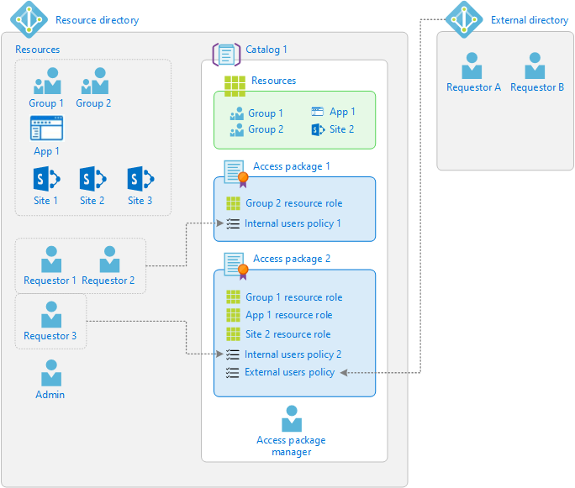
Access Management via Entitlement Management
Entitlement management is an identity governance feature that enables organizations to manage identity and access lifecycle at scale, by automating access request and approval workflows, access assignments, reviews, and expiration.

Slide 39
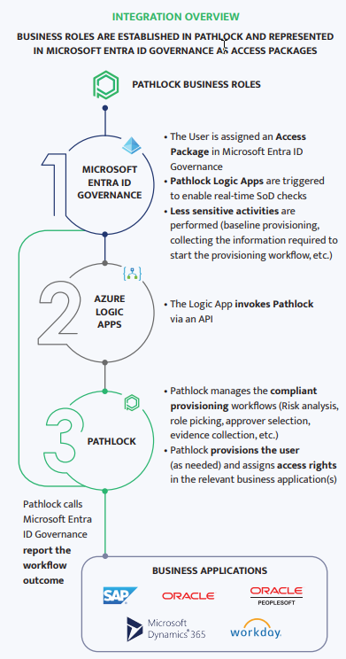
Access Management via Entitlement Management + external GRC product
With the integration from Microsoft Entra ID Governance to Pathlock and other partner products, customers can take advantage of fine-grained separation-of-duties checks enforced in those products, with access packages in Microsoft Entra ID Governance.
Notes:
Pathlock and Microsoft Entra ID Governance | Pathlock

Slide 40
Choose a Path
If the customer has | Position
SAP IDM | Microsoft Entra ID + Microsoft Entra ID Governance
SAP IDM + SAP AC (aka SAP GRC) | Microsoft Entra ID + Microsoft Entra ID Governance + SAP AC + SAP Cloud Identity Access Governance (IAG bridges to SAP AC and provides cloud app support) *Using Pathlock can be an alternative to SAP GRC
Pathlock | Microsoft Entra ID + Microsoft Entra ID Governance + Pathlock

Slide 41
Use Microsoft Entra for reporting
Microsoft Entra includes built-in reports, as well as workbooks that surface in Azure Monitor based on audit, sign-in, and provisioning log data
Usage and insights reports for an application-centric view on sign-in data.
Monitor for unusual account creation and deletion, and unusual account usage.
Query Microsoft Graph to obtain data for use in a report. For example, you can retrieve a list of inactive user accounts in Microsoft Entra ID.
Notes:
Migrate identity management scenarios from SAP IDM to Microsoft Entra | Microsoft Learn

Slide 42
Use Microsoft Entra for reporting
You can export data from Microsoft Entra admin center for use in generating your own reports. For example, you can download a list of users and their attributes or download logs, including the provisioning logs, from the Microsoft Entra Admin Center.
You can create custom reports with Azure Data Explorer, PowerBI or other tools you are familiar with.
You can use the PowerShell cmdlets atop Microsoft Graph APIs to export and restructure content suitable for reporting.
Notes:
Migrate identity management scenarios from SAP IDM to Microsoft Entra | Microsoft Learn

Slide 43
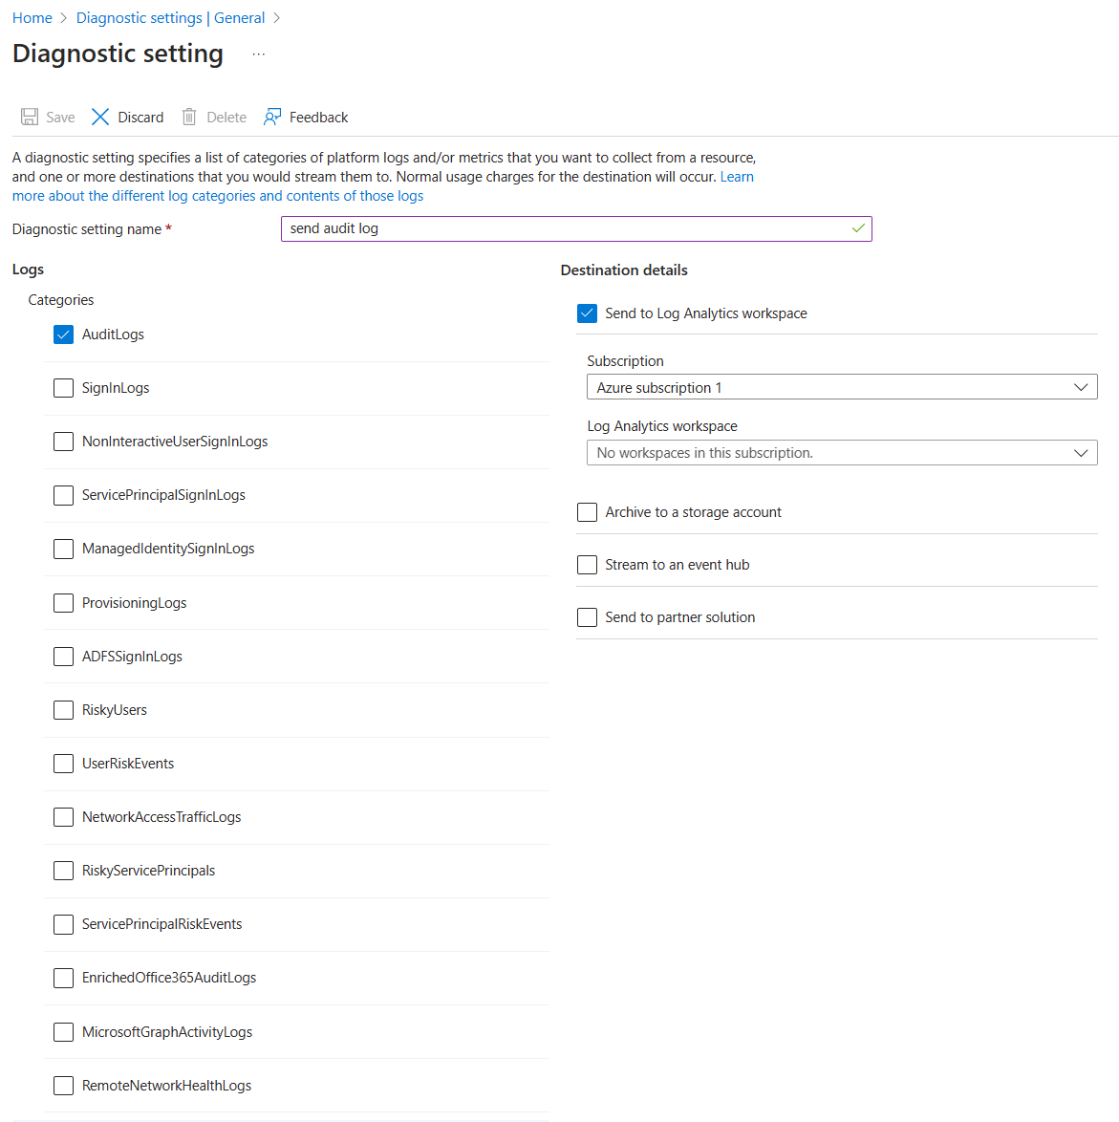
Use Microsoft Entra for reporting
Export data for SIEM, Azure Monitor or other storage solutions
Archive & report with Azure Monitor - Entitlement Management Reporting
Notes:
Migrate identity management scenarios from SAP IDM to Microsoft Entra | Microsoft Learn

Slide 44
Migrate Identity Federation (B2B)
Some organizations may be using SAP IDM identity federation to exchange identity information about users across company boundaries.
Microsoft Entra (B2B) can connect with different organizations (SAML/OIDC) for collaboration
Microsoft Entra includes capabilities for a multitenant organization, that more than one Microsoft Entra ID tenant, to bring together users from one tenant for application access or collaboration in another tenant.
Notes:
Migrate identity management scenarios from SAP IDM to Microsoft Entra | Microsoft Learn

Slide 45
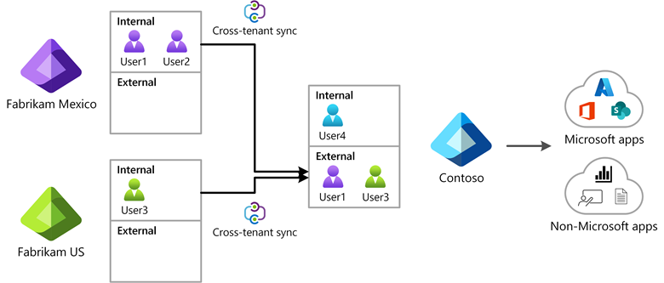
Migrate Identity Federation (B2B)
Microsoft Entra External ID includes B2B collaboration capabilities that allow your workforce to work securely with business partner organizations and guests and share your company's applications with them.
Notes:
Migrate identity management scenarios from SAP IDM to Microsoft Entra | Microsoft Learn

Slide 46
Migrate Identity Federation (B2B)
Microsoft Entra ID can provision and provide SSO capabilities for B2B Guest users to SAP Applications, such as SAP Cloud Identity Services
Lifecycle of B2B Guest users can be managed using Self-Service Sign-Up and Entitlement Management to govern the identity and access lifecycle for those external users.
Notes:
Migrate identity management scenarios from SAP IDM to Microsoft Entra | Microsoft Learn

Slide 47
Migrate applications requiring directory services
Some organizations may be using SAP IDM as a directory service, for applications to call into to read and write identities.
If you are using Microsoft Entra to populate workers from SuccessFactors into on-premises Active Directory, then the applications can read users and groups (with Group Writeback) from that Windows Server Active Directory.
Notes:
Some organizations may be using SAP IDM as a directory service, for applications to call into to read and write identities. Microsoft Entra ID provides a directory service for modern applications, enabling applications to call via the Microsoft Graph API to query and update users, groups and other identity information.
For applications that still require an LDAP interface to read users or groups, Microsoft Entra provides several options:
Microsoft Entra Domain Services provides identity services to applications and VMs in the cloud, and is compatible with a traditional AD DS environment for operations such as domain join and secure LDAP. Domain Services replicates identity information from Microsoft Entra ID, so it works with Microsoft Entra tenants that are cloud-only, or those synchronized with an on-premises AD DS environment.
If you are using Microsoft Entra to populate workers from SuccessFactors into on-premises Active Directory, then the applications can read users from that Windows Server Active Directory. If your applications also require group memberships, then you can populate Windows Server AD groups from corresponding groups in Microsoft Entra. For more information, see Group writeback with Microsoft Entra Cloud Sync.
If your organization has been using another LDAP directory, then you can configure Microsoft Entra ID to provision users into that LDAP directory.

Slide 48
Migrate applications requiring directory services
If your app is running on Azure, you can consider Microsoft Entra Domain Services, for Apps compatible with AD DS environment.
If your organization has been using another LDAP directory, then you can configure Microsoft Entra ID to provision users into that LDAP directory.
Notes:
Some organizations may be using SAP IDM as a directory service, for applications to call into to read and write identities. Microsoft Entra ID provides a directory service for modern applications, enabling applications to call via the Microsoft Graph API to query and update users, groups and other identity information.
For applications that still require an LDAP interface to read users or groups, Microsoft Entra provides several options:
Microsoft Entra Domain Services provides identity services to applications and VMs in the cloud, and is compatible with a traditional AD DS environment for operations such as domain join and secure LDAP. Domain Services replicates identity information from Microsoft Entra ID, so it works with Microsoft Entra tenants that are cloud-only, or those synchronized with an on-premises AD DS environment.
If you are using Microsoft Entra to populate workers from SuccessFactors into on-premises Active Directory, then the applications can read users from that Windows Server Active Directory. If your applications also require group memberships, then you can populate Windows Server AD groups from corresponding groups in Microsoft Entra. For more information, see Group writeback with Microsoft Entra Cloud Sync.
If your organization has been using another LDAP directory, then you can configure Microsoft Entra ID to provision users into that LDAP directory.

Slide 49
Extend Microsoft Entra through integration interfaces
Applications can call Microsoft Entra via the Microsoft Graph API to query and update identity information, configuration and policies, and retrieve logs, status, and reports.
Administrators in a tenant with Microsoft Entra ID Governance can also configure calls to custom Azure Logic Apps from entitlement management and lifecycle workflows. These allow customization of the user onboarding, offboarding, and access request and assignment processes.
Custom connectors are available via Services and integration partners
Notes:
Microsoft Entra includes multiple interfaces for integration and extension across its services, including:
Applications can call Microsoft Entra via the Microsoft Graph API to query and update identity information, configuration and policies, and retrieve logs, status, and reports.
Administrators can configure provision to applications via SCIM, SOAP or REST, and the ECMA API.
Administrators can use the inbound provisioning API to bring in worker records from other system of record sources to supply user updates to Windows Server AD and Microsoft Entra ID.
Administrators in a tenant with Microsoft Entra ID Governance can also configure calls to custom Azure Logic Apps from entitlement management and lifecycle workflows. These allow customization of the user onboarding, offboarding, and access request and assignment processes.

Slide 50
License Requirements
To successfully transition from SAP IDM to Microsoft Entra ID for comprehensive identity, provisioning, and access management governance, customers will need to acquire the following licenses:
Microsoft Entra ID P1 + Microsoft Entra ID Governance or Microsoft Entra Suite
Front-Line Workers licenses are also available
Customers can enable 30-days trial of Microsoft Entra ID Governance
Notes:
Microsoft Entra ID Governance licensing fundamentals - Microsoft Entra ID Governance | Microsoft Learn

Slide 51
Recommended actions
Learn more about Microsoft Entra ID Governance: https://aka.ms/entra/identitygovernance
View the Microsoft Mechanics video: https://aka.ms/IDGovMechanics
Walk through the Interactive Guides: https://aka.ms/EntraIDGovGuides
Read documentation: https://aka.ms/Entra/IDGovDocs
Set up a free trial: https://aka.ms/EntraTrialsPage
Read SAP IDM Migration guide: https://aka.ms/MigrateFromSAPIDM
Plan deploying Microsoft Entra for user provisioning with SAP source and target apps

Slide 52
Thank you

